Slide 1
Controlling your UKMARSBOT from your Android phone
David Hannaford
Updated Dec 2022

Slide 2
All you need to do !!
Install MIT AI2 Companion on your phone from the Play Store
Write an app for your phone that can send and receive Bluetooth messages to UKMARSBOT
Load the app you have written onto your phone and install it there using the MIT App Inventor 2 companion
Write some code on UKMARSBOT that receives the Bluetooth messages and turns them into motor control actions
Put the 3 Bluetooth components (2 resistors & a diode) on the UKMARSBOT main board and plug in the HC05 module
Configure the Bluetooth connection
Fire up the app and control your robot

Slide 3

So how do we do all that?
Start by going to Google Play Store and searching for MIT App Inventor
Select MIT AI2 Companion and install it on your phone. It will put an icon on your phone that looks like this:
Don’t open it yet
MIT AI2
Companion

Slide 4
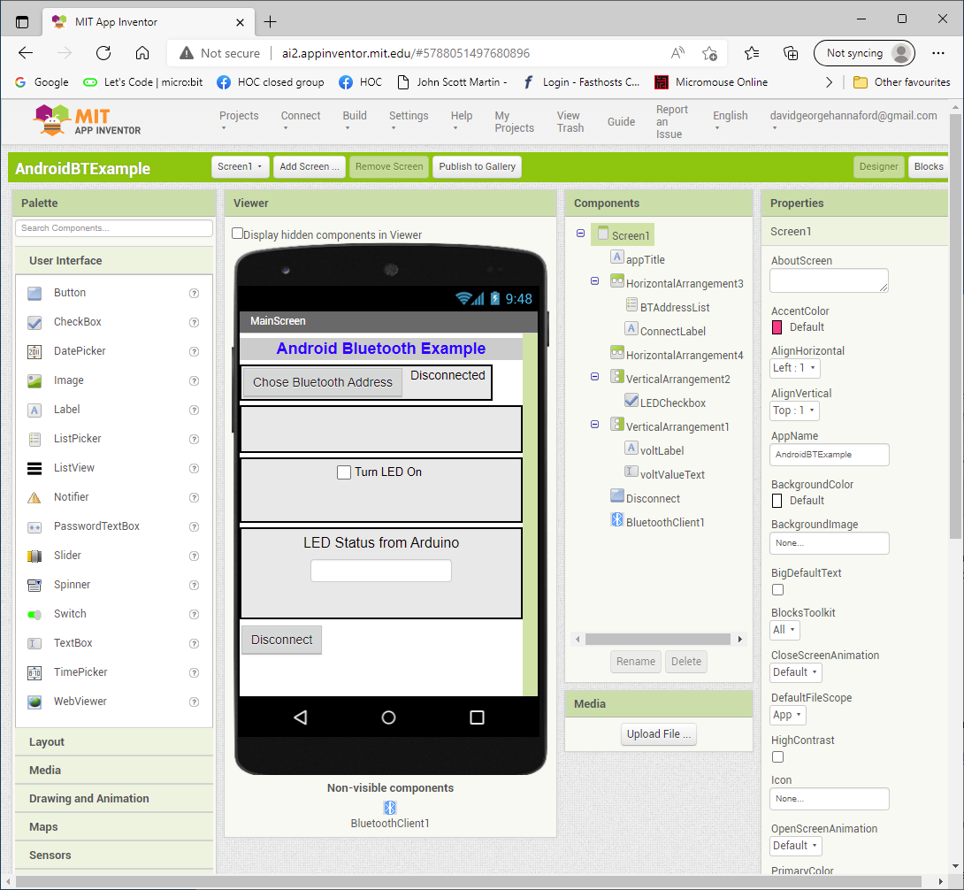
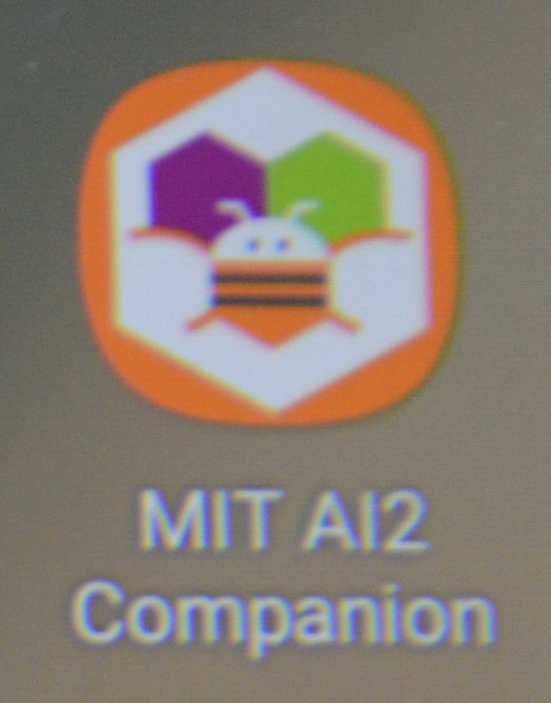
Writing the App on your PC
Use MIT App Inventor 2 on the internet. Get to it at https://appinventor.mit.edu/ and click on Create apps, then sign in with a google account
You will see a developers screen something like this
In Designer mode:
The Viewer section in the middle shows your phone screen layout as you put elements into it.
The Palette on the left shows components available
And the right side shows the Components in use and their Properties
You also need to go to your play store and find and install MIT AI2 Companion on your phone

Slide 5
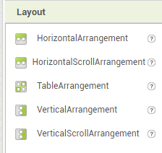
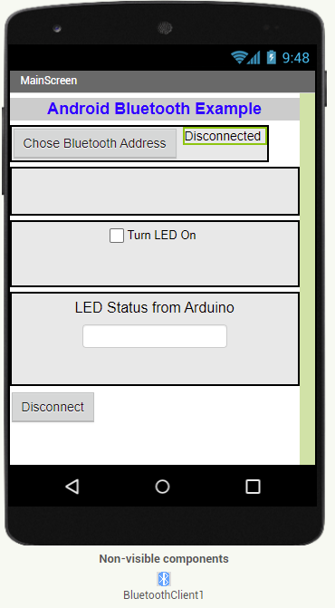
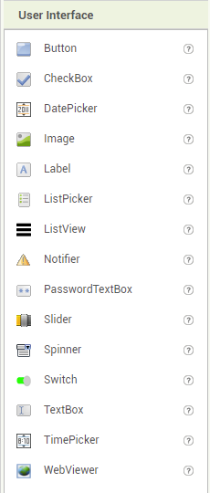
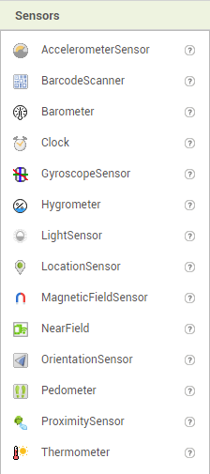
Designer – Palette items

Slide 6
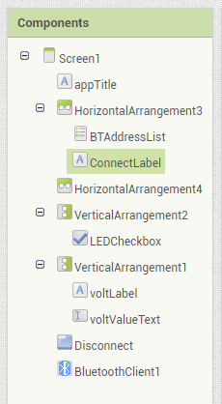
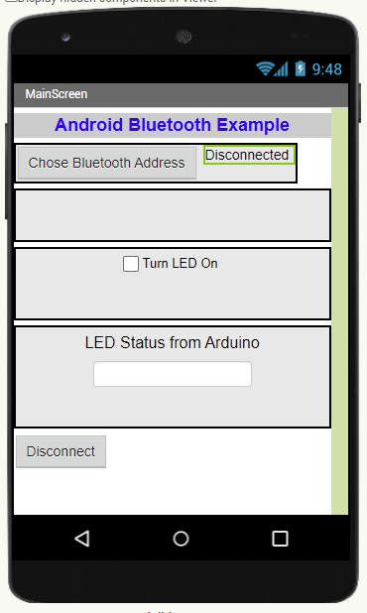

Designer screen
This sets up and shows the components that have been added to the screen design.
These components are referenced by the blocks code that follows

Slide 7
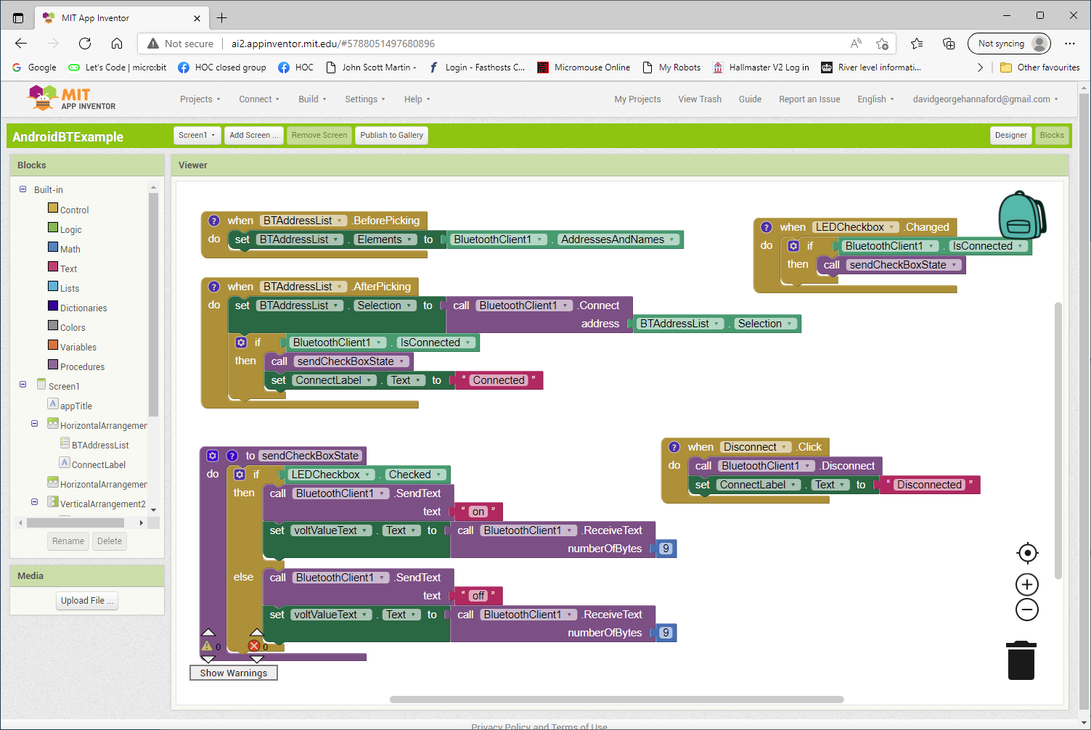
Writing the code behind the components
In Blocks mode: you build the code behind the elements that you have put on the screen using the drag and drop style as used with most Blocks programs

Slide 8
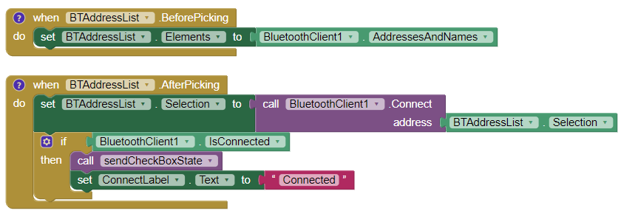
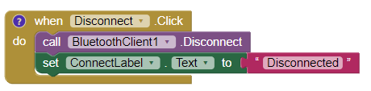
Blocks - Bluetooth components
Bluetooth address selection, connection & disconnection

Slide 9
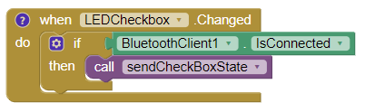
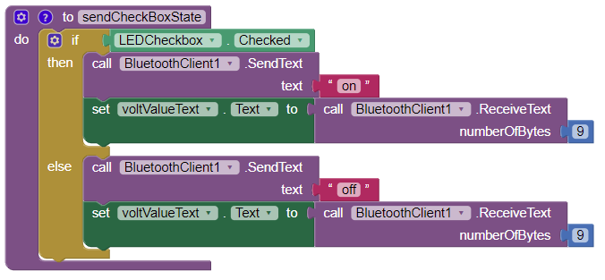
Blocks - Send commands components
These blocks process the checkbox on the screen, send text “on” or “off” to the robot via Bluetooth and update the returned value on the screen

Slide 10
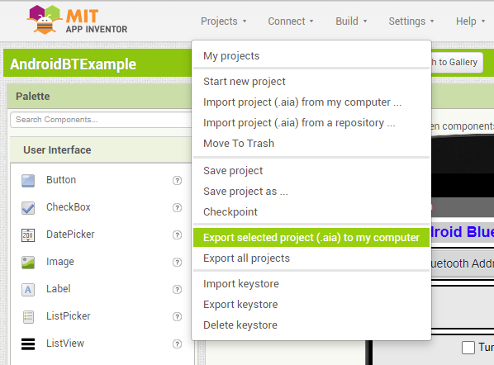
Saving your Android app
Projects are normally stored against your log in in the cloud
You can also save them to your PC by clicking on My Projects/ Export selected project(.aia) to my computer as shown below
You can load up a .aia file from your computer using the import feature on the same menu

Slide 11
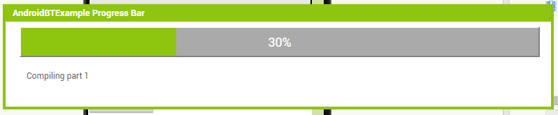
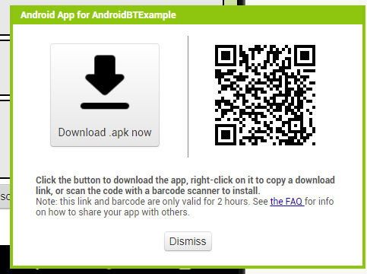
Building the app for your phone
Click on the Build button and select Android app (apk) from the dropdown and wait for the build to complete
When complete, this screen will appear

Slide 12
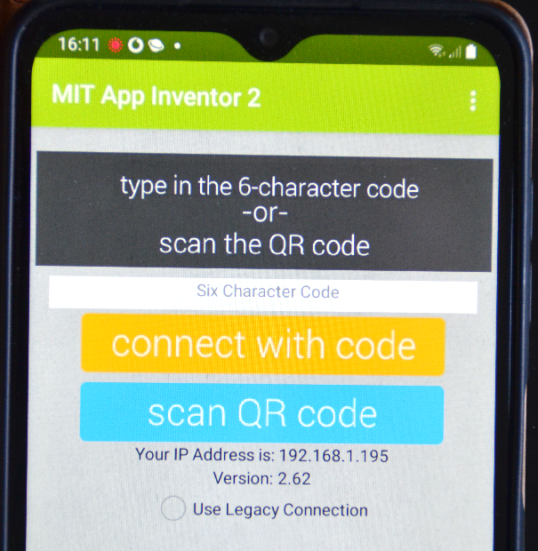
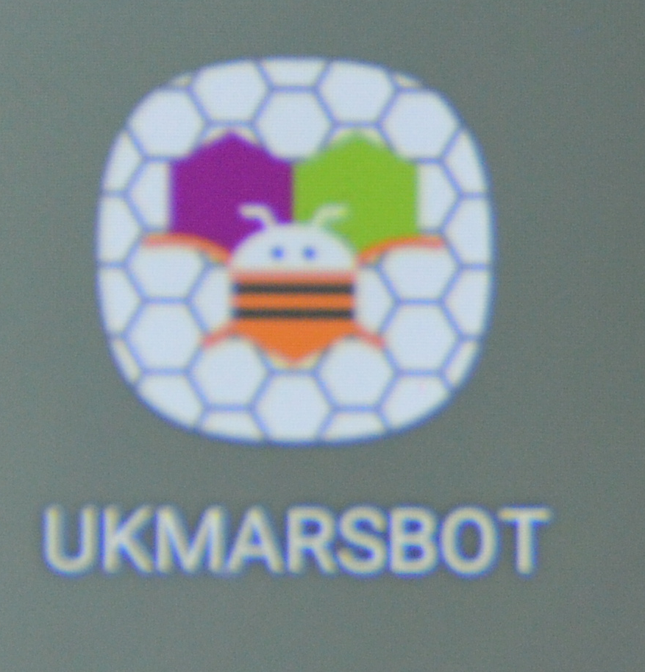
Putting the app on your phone
On your phone open your MIT AI2 Companion app
Tap on “scan QR code” on your phone then point it at the QR code on the build screen on your PC (enabling the app to use your camera if needed).
When it recognises the QR code you should get one or two messages asking you if you want to download the file.
Confirm these and it will install the app on your phone and create a new icon for it looking like this

Slide 13
Now for the Arduino Nano code – page1
Serial.begin(9600); // in Setup section of sketch
void bluetooth(){
digitalWrite(LED13, LOW);
while (true)
{delay (30);
Serial.write("app start");
String t; // empty string to store messages from Android
while (Serial.available()) {
t += (char)Serial.read();
}
This example receives ON or OFF message from the phone and switches the LED on or off on pin 13

Slide 14
Now for the Arduino Nano code – page2
if (t.length()) {
if (t == "on") {
digitalWrite(LED13, HIGH);
Serial.write("LED is on");
}
else if (t == "off") {
digitalWrite(LED13, LOW);
Serial.write("LED - off");
}
}
}
}
This example receives ON or OFF message from the phone and switches the LED on or off on pin 13

Slide 15
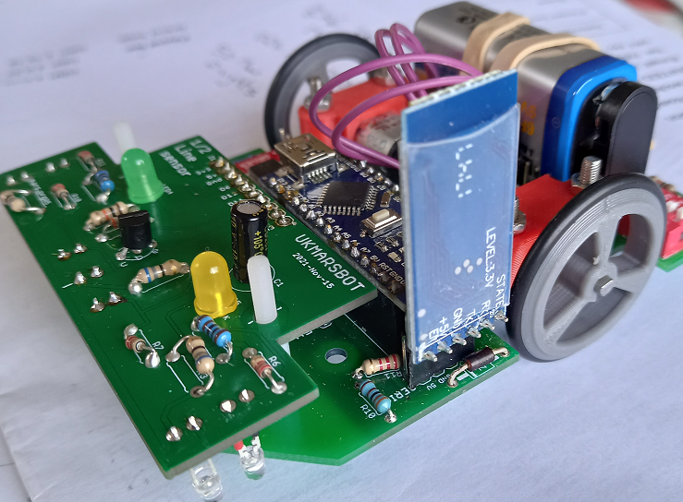
UKMARSBOT hardware needed
If you have a UKMARSBOT marked version 20210924 it just needs the 3 Bluetooth components (R10 is 3.9KὨ, R11 is 2.2KὨ, diode is 1N4001 or similar) and the 4 way connector added to the board, plus an HC05 Bluetooth module - £4 from thepihut.com
If you have an older board you will need to make up an adaptor board for the connection - see instructions for this at: https://ukmars.org/projects/ukmarsbot/developer-notes/serial-over-bluetooth/
Plug the HC05 module into the connector with one of the 6 pins out on each side of the 4 way connector
WARNING - Make sure you plug the HC05 in with the flat side without components on the outside of the robot.

Slide 16
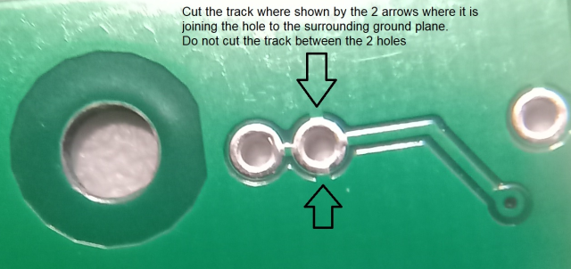
Bug Fix on board
Important – if you are using the board labelled UKMARSBOT 20210924 there is a minor fault that can be easily corrected. On the bottom of the board where R10 meets R11 the via for the R10 lead is also connected to ground at each side of the pin. Use a sharp knife to cut the ground connection at each side of the connection, leaving the connection between R10 and R11.

Slide 17
Configure your Bluetooth connection
Switch on UKMARSBOT – HC05 will flash quickly
To pair your Android phone with the HC05
  In Settings / Connections switch on Bluetooth then click on it to see available devices. HC05 should be shown. Click on it
Enter pin number 1234 into Bluetooth pairing request screen
Open the android app that you wrote
On top of screen click on Choose Bluetooth Address – this should establish a connection to UKMARSBOT. The HC05 should now just give a double flash every 5 seconds
App screen should now appear for you to control your robot

Slide 18
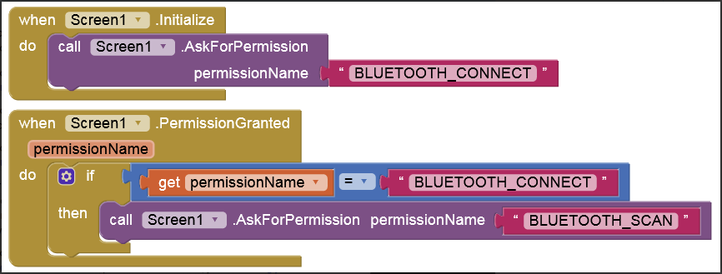
Bluetooth permissions
If you get a message: Runtime Error – Need android.permission.BLUETOOTH_CONNECT permission for AttributionSource ………………………
Add these items to your app

Slide 19
Want to see more information?
Adding buttons / more checkboxes etc – see User interface reference at http://ai2.appinventor.mit.edu/reference/components/userinterface.html
Neil at Fortronics has put a presentation on youtube for controlling a remote car with his Android Nexus tablet. You can see this at https://www.youtube.com/watch?v=2_y_m9rVgtE&t=153s
I have the Android .aia file for this but not the Arduino code
Have fun with using this information to control your robot and good luck

