Slide 1
A Micro-Python based UKMARSbot maze solver
D Hannaford Jan 2024

Slide 2
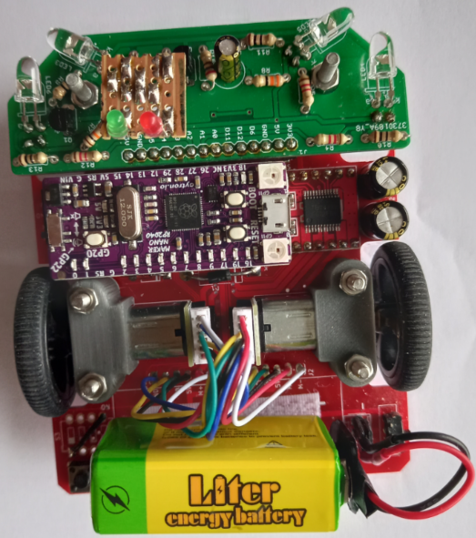
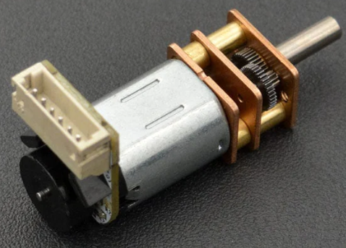
Hardware
UKMARSbot Peter Harrison v1.3 main PCB
Adrian Eddleston v5 PCB with four LED wall sensors using TLCR5800 5mm red 4 degree angle LEDs, 2 forward and 2 angled
Standard Python mods to main PCB
  Remove Battery feed resistor, Disable 5v from CPU, Join 5v to 3v at sensor board connector, remove and short out 4 way switch
  Cytron Maker Nano RP2040 pin compatible CPU board instead of Arduino Nano
Pi Hut 30:1 6V Micro Metal Gear motors with built in magnetic encoders https://www.dfrobot.com/product-1431.html
Liter 9v 1200mA rechargeable LiPo battery

Slide 3
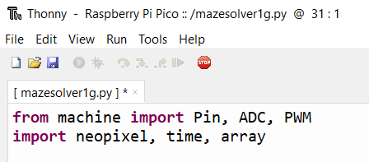
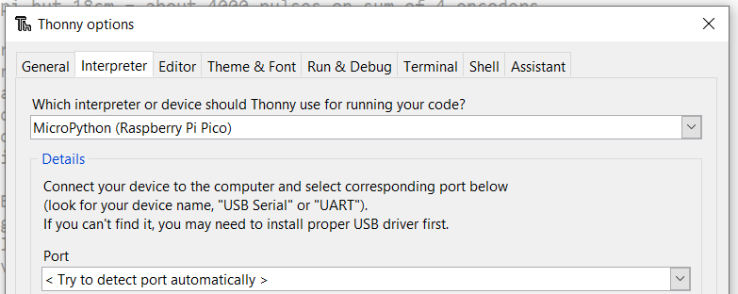
Software Development environment
Thonny 3.3.10 IDE for Windows 10 (64 bit) on Acer V15Nitro Laptop
  Includes micro-python 3.7.9 (32 bit) and Tk 8.6.9
  Later versions available (4.1,4) from www.Thonny.org but don’t use earlier ones as they won’t support the RP2040 chip as used in the Cytron Maker Nano
To select the right version, choose the Run option on the menu, then select Interpreter then select MicroPython (Raspberry Pi Pico) from dropdown

Slide 4
Simplified approach
No fixed systick – processing loop runs as fast as the code wants to go
No acceleration/ deceleration profiles for motors
Fixed speed set by motor PWM value
No separate forward or rotational controllers
Encoders used to measure distances gone - encoder interrupts set by :
  Leftenc1.irq(lambda p:leftcount1()) Leftenc2.irq(lambda p:leftcount2())
  Rightenc1.irq(lambda p:rightcount1()) Rightenc2.irq(lambda p:rightcount2())
Encoder routines (leftccount1, leftcount2, rightcount1 and rightcount2) just add 1 to the relevant encoder count and return
8 programs selectable using buttons and sensor LEDs before start
Debug mode prints out key variables and pauses at end of each move

Slide 5
Mazesolve routine and main processing loop
Maze and wall arrays will have already been set up
Sets up initial values and calls the calibrate routine
If at start, waits for button press to start then backs up to rear wall
Main loop processes at each cell boundary
  read photo sensors, set walls in wall array for cell being looked in to
  flood the maze in the maze array, using proclist array
  decide where next to go (go 1 cell ahead, or turn L or R or turn around),
  call routine for move selected, which takes us to the next cell boundary
  check if reached the target cell in going out or back to start if coming back.
If target reached, move to centre of cell, stop mouse, beep and reset route direction for flood, then go back into main loop again for run in opposite direction

Slide 6
wherenext routine
Look in turn at each 4 adjacent cells to the current one and determine if there is a wall between the current cell and that cell
If there is no wall in the way and the flood number is lower than the flood number for the current cell we want to move next to that cell
Depending on the direction we are currently heading in, and on which side the lower flood number is, we decide whether to go ahead, turn right, turn left or turn round
Pass the type of move back to the mazesolve routine in the move field for it to call the relevant routine to execute the move
If there are several possible moves, the sequence of the tests done above will prioritise the one which goes straight ahead

Slide 7
Wall following/ avoiding
At the start of the run, the calibrate routine measures the 2 side distances in the start cell
When moving forward in the goahead routine, it reads the current side distances with the photoread routine and if either wall is nearer than the initial calibration value it uses proportional control to adjust the motor speeds to move away from it.
This approach avoids the mouse turning as the beam spot drops off the end of a wall. Also if there are no side walls we can still get mouse direction correction off the posts when the beam spots are fully on the posts

Slide 8
Turn logic for left and right turns
Move forward straight 1 cm from cell boundary
Reset inner wheel speed to 1/3 of outer one
Turn for the required number of encoder pulses on the outer wheel, whilst checking that inner wheel encoder count * 3 equals the count from the outer wheel. Use proportional error to adjust motor speeds to maintain the 3 to 1 ratio. This loop runs at full speed.
Reset inner wheel back to speed of the outer one
Move forward straight 1 cm to next cell boundary
While moving forward at start and end of turn. wall avoidance will be active. This helps to align the mouse at the end of the turn

Slide 9
Flood routine
floodmaze (strt,fin) floods from start cell to finish cell
Initially clear the flood table to all high values
Set current cell to start cell and put a zero in the start cell
Main loop
  Check for walls in turn on each side of current cell and if no wall put cell number plus 1 in the adjacent cell unless that cell already has a lower number in it
  For each flood cell updated add the cell number to the proclist
  Get the next cell number from the proclist and set as the current cell
  check if item just processed is the finish cell number and go out of main loop
If we run out of proclist items before reaching the finish cell, mark it as a flood failure
Only about 50 lines of code

Slide 10
Routines and arrays
Around 40 def routines
backup, beep, buttonwait, calibrate, checkspeed, encoder reset, encodertest, flashLEDs, floodclear, floodmaze, goahead, goonecellahead, halt, LEDtest, leftcount1, leftcount2, motortest, nowtime, pause, photoread, phototest, progdisp, rightcount1, rightcount2, setoutsidewalls, setwalls, showflood, showLEDwalls, showwalls, stop, switchread, switchtest, turnaround, turnleft, turnright, wherenext, mazesolve
Arrays – walls, maze, proclist
In debug mode, routines print when called with key variables and pause briefly at end of each move
Over 1000 lines of code

Slide 11
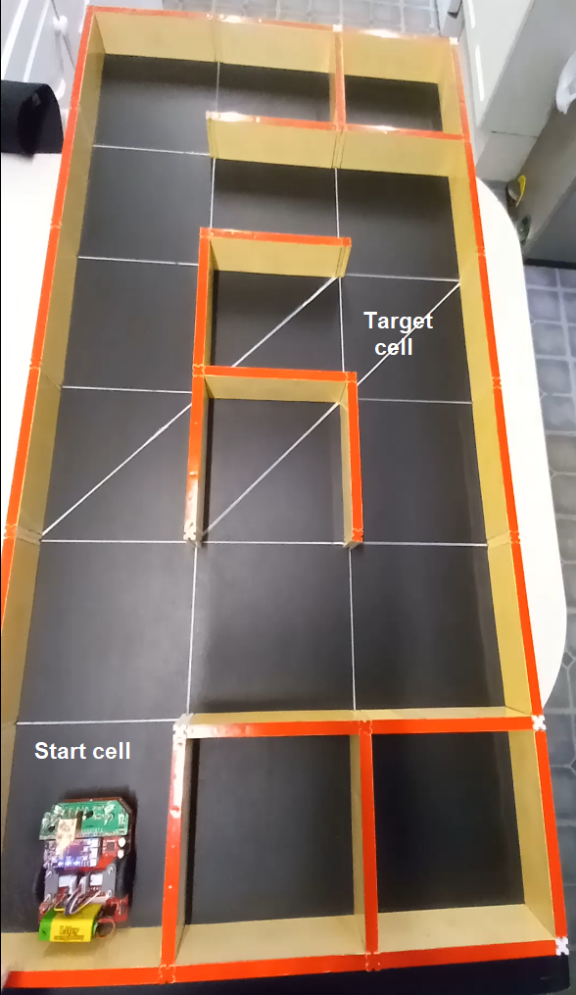
So does it work?
Tested on my home 6 x 3 maze although maze is actually defined as being 6 x 4 with one inaccessible column of cells
Start cell is bottom left as usual
Target cell is defined for the test as being in 4th row North and 3rd column East
Walls set so that we can see if it finds a first valid route to the target then a better one on subsequent runs

Slide 12
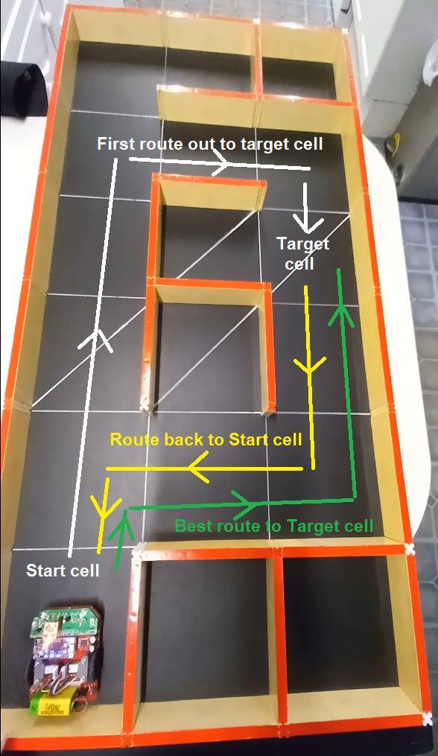
What would we expect it to do?
Explore run 1 ( path length 8 cells)
Go ahead NORTH until level with or past the Target cell
Turn EAST until level with Target cell
Head SOUTH to get to Target cell
Explore back to Start (path length 6 cells )
Head SOUTH until wall ahead, turn right
Head WEST until level with Start, turn left
Head SOUTH again to Start cell
Take best route to target (path length 6 cells)
Head NORTH 1 cell
Turn right and head EAST 2 cells
Turn left and head NORTH 2 cells

Slide 13
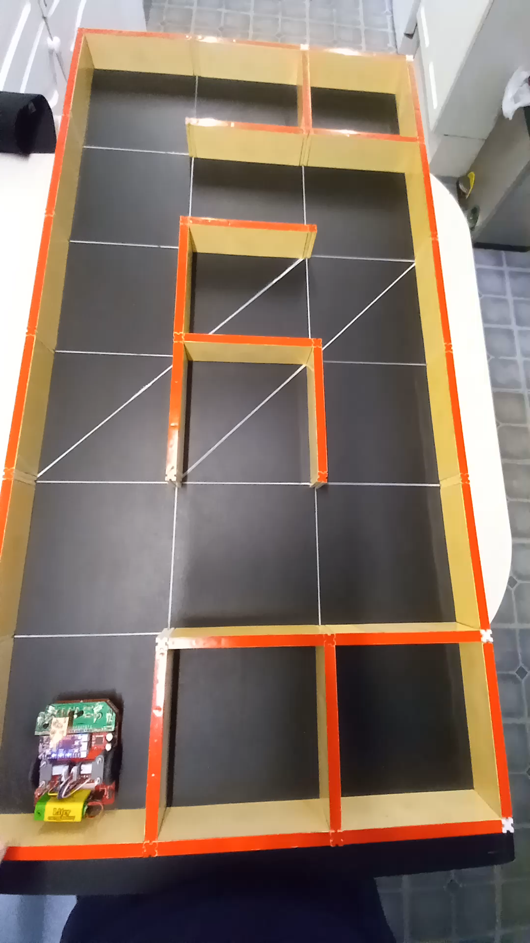
Here is the demo run

Slide 14
Code Sample
You can see the current code and this presentation at
https://www.davidhannaford.com/ukmars/
It will probably need a bit more tweaking to go as well in a full size maze

